Slide 1
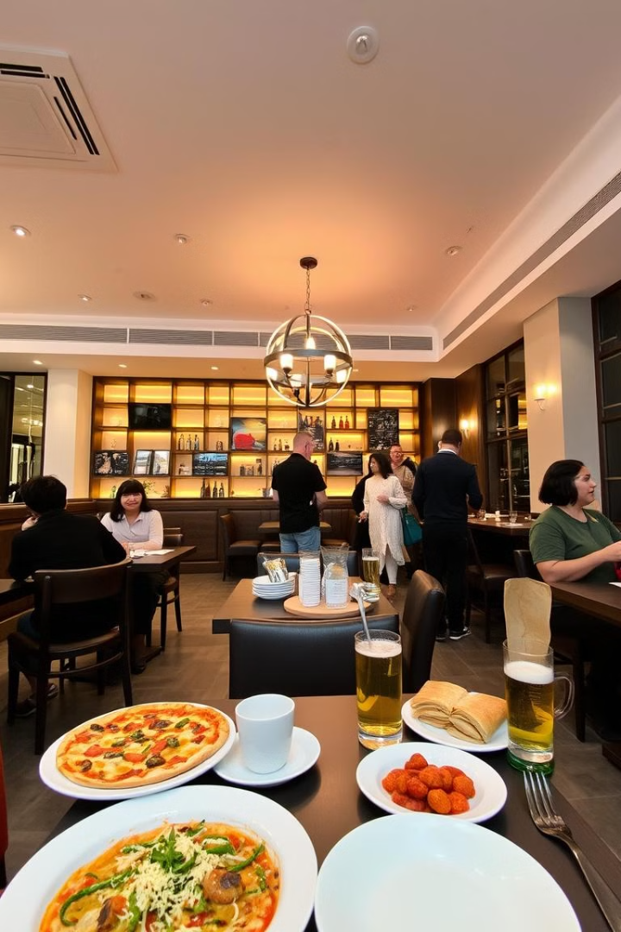
Online Restaurant Menu Website
This project aims to design an appealing and functional restaurant menu website using basic HTML and CSS. The site will allow users to easily browse the menu, explore restaurant details, and learn about ongoing promotions.
ps

Slide 2

Key Features
1
Home Page
2
Navigation Menu
The home page will welcome users with an eye-catching banner showcasing the restaurant's atmosphere or signature dishes.
A clear navigation menu will allow users to easily navigate to the Menu, About Us, and Contact pages.
3
Menu Page
A well-organized menu will display the restaurant's offerings, categorized into Appetizers, Main Course, and potentially other sections like Desserts or Drinks.

Slide 3
Home Page
Banner Image
Navigation Menu
The home page banner will feature a compelling image that showcases the restaurant's ambiance or one of its most popular dishes. This will create an initial impression and entice users to explore further.
The navigation menu will be prominently displayed, allowing users to seamlessly transition to other sections of the website, including the Menu, About Us, and Contact pages.

Slide 4
Menu Page
Categories
Clear Presentation
The menu will be organized into categories, such as Appetizers, Main Course, and Desserts, to make it easy for users to find what they are looking for.
Each menu item will be presented with a clear, concise description and price, making it easy for users to understand what they are ordering.

Slide 5
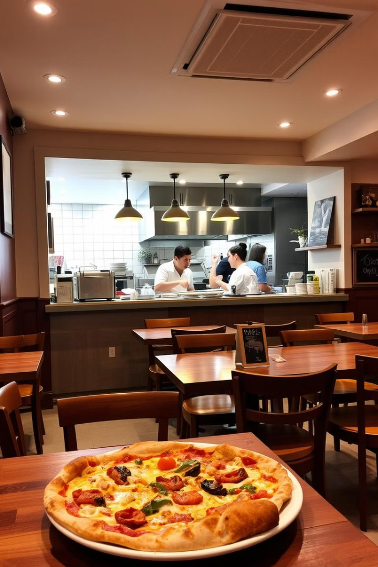



About Us Page
Restaurant Story
The About Us page will provide a brief but engaging narrative about the restaurant, its origins, and its philosophy.
Team Photos
The page could include photos of the restaurant team, showcasing the people behind the delicious food.
Restaurant Values
The About Us section will highlight the restaurant's commitment to quality, fresh ingredients, and customer satisfaction.

Slide 6
Contact Page
Purpose
To provide users with an easy way to contact the restaurant for reservations, inquiries, or feedback.
Features
A contact form, a map with the restaurant's location, and contact details like phone number and email address.

Slide 7



Additional Features
Customer Testimonials
Including customer testimonials can enhance the website's credibility and showcase positive experiences.
Online Ordering
Implementing online ordering functionality will allow users to order food directly from the website, providing convenience and efficiency.
Social Media Integration
Integrating social media icons allows users to connect with the restaurant on platforms like Facebook, Instagram, and Twitter.

Slide 8
Responsive Design
1
Adaptive Layout
The website should adapt to various screen sizes and orientations, ensuring a consistent and optimal user experience across devices.
2
Mobile-First Approach
Prioritizing the mobile experience will ensure the website is accessible and usable on smaller screens.
3
Cross-Browser Compatibility
The website should work seamlessly across popular web browsers, such as Chrome, Firefox, Safari, and Edge.

Slide 9
Project Conclusion
The online restaurant menu website project will be a valuable tool for the restaurant, providing a digital platform to showcase their offerings, engage with customers, and ultimately, drive more business.

